Slide 1
TRANSFORMERS

Slide 2
TRANSFORMER BASICS
An alternating-current emf device in a certain circuit has a smaller resistance than that of the resistive load in the circuit. This is a fact of life based on how AC generators are designed and built and what loads they have to deal with, once put in real-world usage.

Slide 3
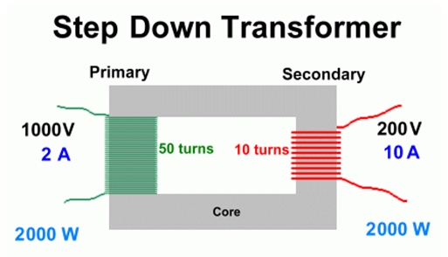
TRANSFORMER BASICS
To increase the transfer of energy from the device to the load, a transformer will be connected between the two. See one example below in Figure 1.
Figure 1 A Step Down Transformer designed for primary voltage V_{p}=1000V (RMS value) and secondary voltage V_{s}=200V (RMS value)

Slide 4
TRANSFORMER BASICS
The transformer in Figure 1 is designed to take 1000 volts RMS at input (primary winding) and produce 200 volts RMS at output (secondary winding).
The number of turns in the primary winding (N_{p}) is five times higher than the same in the secondary winding (N_{s}).
The actual value of N_{p} is determined by several factors like how much magnetic flux is generated in the core of the transformer, how much primary voltage is the transformer designed for, what is the intended frequency of operation, etc. I can supply you the exact equation if necessary.

Slide 5
TRANSFORMER BASICS
In an ideal lossless transformer, the product of primary current I_{p} and primary voltage V_{p} is equal to the product of secondary current I_{s} and secondary voltage V_{s}.
Hence, the secondary current for the transformer in Figure 1 is five times higher than the primary current.
For a step-up transformer, V_{p}<V_{s}, I_{p}>I_{s}, and N_{p}<N_{s}.
For a step-down transformer, V_{p}>V_{s}, I_{p}<I_{s}, and N_{p}>N_{s}.
Loss-less transformer is being referred to as ‘ideal’ transformer in sample problem 31.08.

Slide 6
TRANSFORMER BASICS
The power factor of the load connected to the transformer’s secondary winding is unity if the load contains only resistances. If the load contains inductors/capacitors too, the power factor will be less than unity.
For a purely-resistive load (unity power factor case), the average power dissipated in the load (also known as consumed power in load) is P=V_{s}I_{s} Watts where V_{s} is secondary voltage (RMS value) in volts and I_{s} is secondary current (RMS value) in Amperes.
For the ideal loss-less transformer, V_{p}/V_{s} = N_{p}/N_{s} =I_{s}/I_{p} where N_{p}/N_{s} is known as the turns-ratio of the transformer. The turns-ratio is frequently given the symbol a.
For a complex load (that is, load containing resistors, inductors, and capacitors), we define power factor p.f.= cos φ where φ is known as the ‘power factor angle’ and will be explained a bit later in this PPT.
The numerical value of the power factor is always less than unity for a complex load.

Slide 7
TRANSFORMER BASICS
The complex load impedance is written in ohm but its value is a complex number.
We write the complex load impedance as Z = R +j X where R, the real part, is known as resistance and X, the imaginary part, is known as reactance.
Both R and X are measured in ohm too.
R generally has a positive value.
X can have a negative value (capacitive load) or a positive value (inductive load).

Slide 8
TRANSFORMER BASICS
For a capacitor of value C farad, the capacitive reactance is X_{c}=1/(2πfC) ohm where f is the frequency of operation.
For an inductor of value L henry, the inductive reactance is X_{L}=2πfL ohm where f is the frequency of operation.
For a load containing resistances, inductances, and capacitances, we need to figure out the total value of complex load impedance Z.
Z will, in general, have a real part R and an imaginary part X.
The power factor angle φ is related to R and X of a load by tan φ =X/R.
For a purely-resistive load, X=0. Hence φ =0 and power factor cos φ =1.

Slide 9
TRANSFORMER BASICS
For a purely reactive load, R=0. Hence φ=π/2 radians. Hence, power factor is equal to zero.
If the sign of X is positive (inductive reactance), the power factor is known as ‘lagging’ and if the sign of X is negative (capacitive reactance), the power factor is known as ‘leading’.
Leading power factor implies that the current is leading the voltage.
Lagging power factor implies that the current is lagging the voltage.
SAMPLE PROBLEM 31.08 is a straightforward one.

Slide 10
SAMPLE PROBLEM 31.08
PROBLEM STATEMENT: A transformer on a utility pole operates at V_{p} = 8.5 kV on the primary side and supplies electrical energy to a number of nearby houses at V_{s} = 120 V, both quantities being RMS values. Assume an ideal step-down transformer, a purely resistive load, and a power factor of unity.
What is the turns ratio N_{p}/ N_{s} of the transformer?
The average rate of energy consumption (or dissipation) in the houses served by the transformer is 78 kW. What are the rms currents in the primary and secondary of the transformer?
What is the resistive load R_{s} in the secondary circuit? What is the corresponding resistive load R_{p} in the primary circuit?
SOLUTION on the next slide

Slide 11
SOLUTION TO SAMPLE PROBLEM 31.08
(a) The turns ratio is given by a = N_{p}/ N_{s} = V_{p}/ V_{s} as we already know (see the third bullet on slide number 6). This leads to a = 8500/120 which works out to be approximately equal to 71. Note that the preferred answer has to be the nearest integer value to the answer actually calculated, since the transformer turns ratio is best specified as an integer value (to the person who would actually be building the whole god-damned thing!).
(b) Referring back to Figure 1, the average consumed power (also known as dissipated power or rate of energy consumption) is given by P = V_{p}I_{p}cosφ, where the power P is in watts, and the two RMS voltages are in volts. The power factor, of course, is a unit-less quantity and, in the case under consideration, has already been given as unity.

Slide 12
SOLUTION TO SAMPLE PROBLEM 31.08: CONTD…
Thus we get 78000 = V_{p}I_{p} =8500I_{p} which gives I_{p} = 9.176 A approximately. We can also write 78000 = V_{s}I_{s} =120I_{s} which gives I_{s} = 650 A.
As a double-check, make sure that a= I_{s} /I_{p} is satisfied (at least, approximately) if you put your calculated values of I_{s} and I_{p} in this equation.
©. R_{s} = V_{s} / I_{s} (based on Ohm’s law) can be used to calculate R_{s}. We get R_{s} = 120/650 ohm = 0.18 ohm (approximately). In a similar manner, R_{p} = V_{p} / I_{p} can be used to calculate R_{p}. We get R_{p} = 8500/9.176 ohm approximately = 926 ohm (approximately).

Slide 13
SOLUTION TO SAMPLE PROBLEM 31.08: CONTD…
As a double check on your calculations, make sure that your calculated values approximately satisfy the following equation:
R_{p} =a*a*R_{s}
where turns ratio a = N_{p}/ N_{s}

Slide 14
TYPES OF CONSTRUCTION
STEP-DOWN versus STEP-UP
SINGLE-PHASE versus THREE-PHASE
SHELL TYPE versus CORE TYPE

Slide 15
CLASSIFICATION BASED ON THE TYPE OF END-USE
1. Power transformer: Used in transmission network, high rating
2. Distribution transformer: Used in distribution network, comparatively lower rating than that of power transformers.
3. Instrument transformer: Used in relay and protection purpose in different instruments in industries, e.g., for extending range of energy-meters
Current transformer (CT)
Potential transformer (PT)

Slide 16
CLASSIFICATION BASED ON COOLING TECHNIQUE
1. Oil­-filled self cooled type
2. Oil­-filled water cooled type
3. Air-blast type (air cooled)
4. Dry type (air cooled)

Slide 17
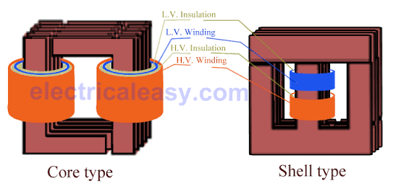
SHELL TYPE versus CORE TYPE

Slide 18
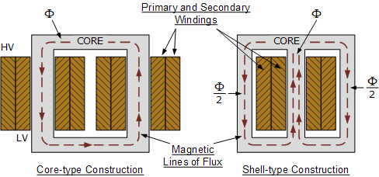

Slide 19
i) Core type transformer
In core type transformer , windings are cylindrical former wound, mounted on the core limbs. The cylindrical coils have different layers and each layer is insulated from each other . Materials like paper , cloth or mica can be used for insulation. Low voltage windings are placed nearer to the core, as they are easier to insulate.
(ii) Shell type transformer
The coils are former wound and mounted in layers stacked with insulation between them. A shell type transformer may have simple rectangular form, or it may have a distributed form

Slide 20
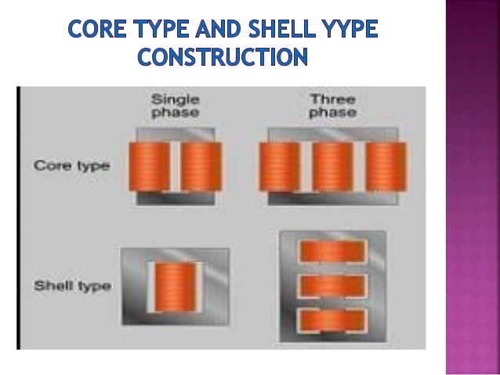

Slide 21
EMF AND VOLTAGE EQUATIONS
Ep= 4.44BAfNp
Es=4.44BAfNs
Ep is primary emf, Es is secondary emf, B is the magnetic flux density in core of the transformer (Wb/meter-squared or Tesla), A is the area of cross-section of the core (meter squared), f is the frequency of operation (in c/s or Hz), Np is the number of turns in the primary winding, and Ns is the number of turns in the senondary winding.
Vp=Ep – Ip*Rp if we ignore iron losses completely
Vs=Es-Is*Rs

Slide 22
LOSSES IN TRANSFORMERS
In any electrical machine, ' loss' can be defined as the difference between input power and output power . An electrical transformer is an static device, hence mechanical losses (like windage or friction losses) are absent in it. A transformer only consists of electrical losses (iron losses and copper losses). Transformer losses aresimilar to losses in a DC machine, except that transformers do not have mechanical losses.

Slide 23
CORE LOSSES OR IRON LOSSES
Eddy current loss and hysteresis loss depend upon the magnetic properties of the material used for the construction of core. Hence these losses are also known as core losses or iron losses.
Hysteresis loss in transformer:
Hysteresis loss is due to reversal of magnetization in the transformer core. This loss depends upon the volume and grade of the iron, frequency of magnetic reversals and value of flux density . It can be given by , Steinmetz formula:
W = ηB fV (watts)
where, η = Steinmetz hysteresis constant, B is the magnetic flux density in core in Wb/meter-squared (Tesla), f is frequency of operation in Hz, and V = volume of the core in meter-cubed

Slide 24
b. Eddy current loss in transformer:
In transformer , AC current is supplied to the primary winding which sets up alternating magnetizing flux. When this flux links with secondary winding, it produces induced emf in it. But some part of this flux also gets linked with other conducting parts like steel core or iron body or the transformer , which will result in induced emf in those parts, causing small circulating current in them. This current is called as eddy current. Due to these eddy currents, some energy will be dissipated in the form of heat.

Slide 25
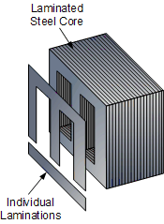
Laminated Construction of the magnetic core helps in reducing the eddy-current loss

Slide 26
Copper Loss
iCopper loss in transformer
Copper loss is due to ohmic resistance of the transformer windings. Copper loss for the primary winding is Ip*Ip* Rp and for secondary winding is Is*Is* Rs . where, Ip and Is are currents in primary and secondary windings, respectively , Rp and Rs are the resistances of primary and secondary windings, respectively .
It is clear that Cu loss is proportional to square of the current, and current depends on the load. Hence copper loss in transformer varies with the load.

Slide 27
TRANSFORMER EFFICIENCY
Just like any other electrical machine, efficiency of a transformer can be defined as the output power divided by the input power . That is efficiency = output / input .
Transformers are the most highly efficient electrical devices. Most of the transformers have full load efficiency between 95% to 98.5% . As a transformer is highly efficient, output and input are having nearly same value, and hence it is impractical to measure the efficiency of transformer by using output / input ratio. A better method to find efficiency of a transformer is using, efficiency = (input ­ - losses) / input = 1 -­ (losses / input).

Slide 28
All-Day Efficiency
Ordinary or commercial efficiency of a transformer can be given as output power/input power.
But in some types of transformers, their performance can not be judged by this efficiency . For example, distribution transformers have their primaries energized all the time. But, their secondaries supply little load all most of the time during day (as residential use of electricity is observed mostly during evening till midnight). That is, when secondaries of transformer are not supplying any load (or supplying only little load), then only core losses of transformer are considerable and copper losses are absent (or very little). Copper losses are considerable only when transformers are loaded. Thus, for such transformers copper losses are relatively less important. The performance of such transformers is compared on the basis of energy consumed in one day .
All-day efficiency = output energy in KWh over a 24-hour period divided by input energy in KWh over the same 24-hour period.
All day efficiency of a transformer is always less than ordinary efficiency of it.

Slide 29
VOLTAGE REGULATION
100x(noload secondary voltage-fullload secondary voltage)/fullload secondary voltage

